Slide 1

Decentralized identity WILL arrive soon
(sooner than expected)
Matteo Midena
Decentralized Identity Specialist
12.04.2024

Slide 2
Decentralized identity WILL arrive soon (sooner than expected)
Matteo Midena
Decentralized Identity Specialist
12.04.2024

Slide 3
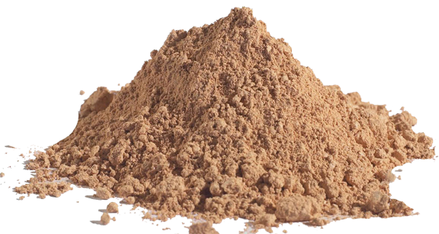


The Story of Cricket Flour

Slide 4
The Story of Cricket Flour

Slide 5


Cricket Flour on paper
Healthy
Helps the planet
Insects have 65% protein
Rich in vitamins
Phosphate, sodium, calcium, fiber
Less water wastefulness
Less greenhouse gases
Less food speculation
Notes:
Benefits
…
Ma perchè vi parlo di farina di grilli?
Perchè secondo me è una metafora efficace e soprattutto attuale per quelle che sono e sono state tutte le innovazioni tecnologiche

Slide 6
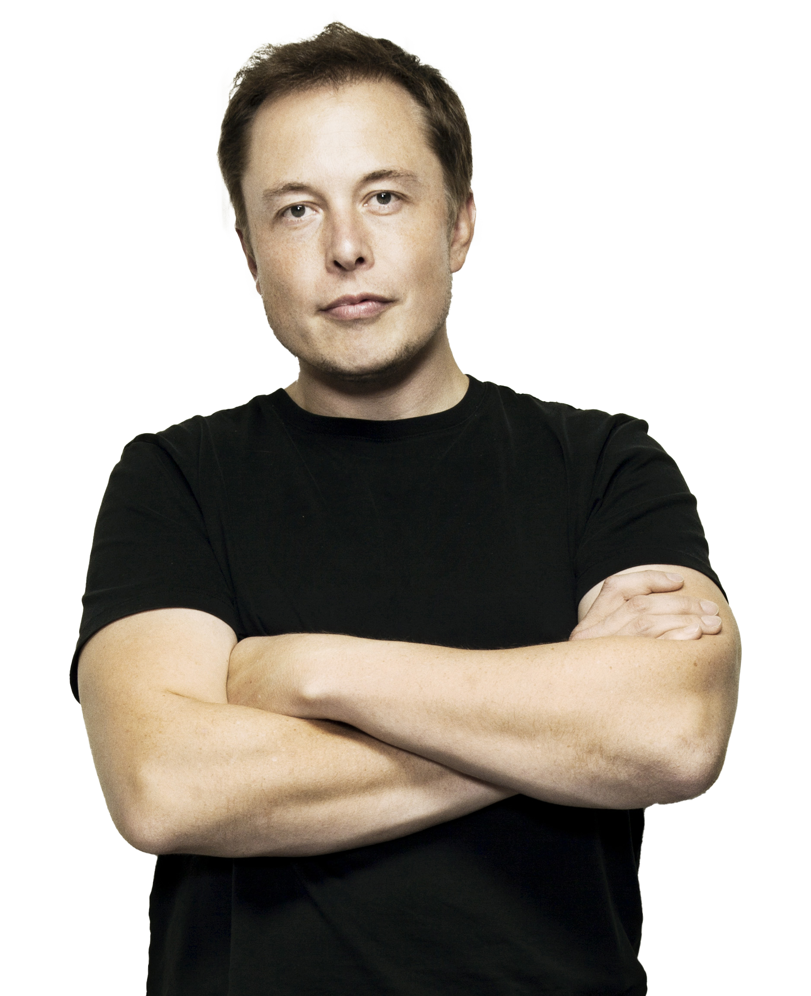
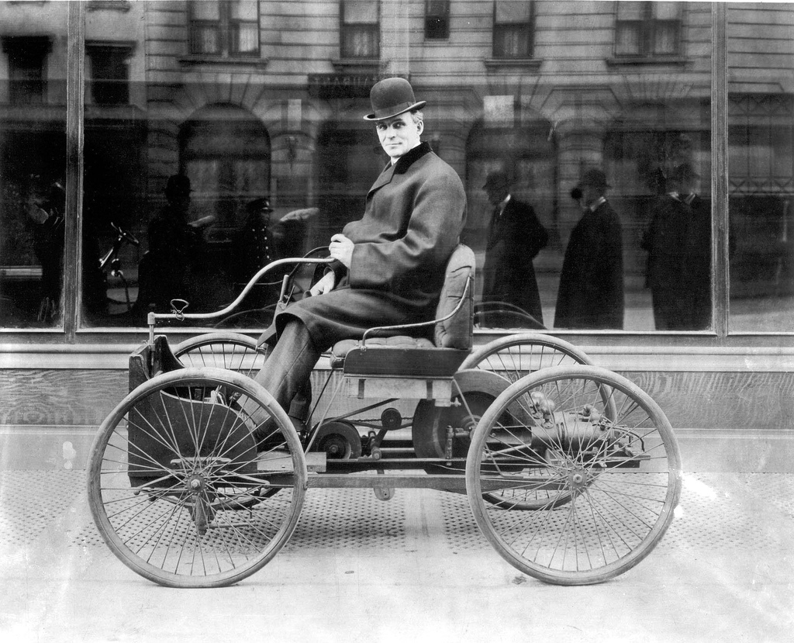
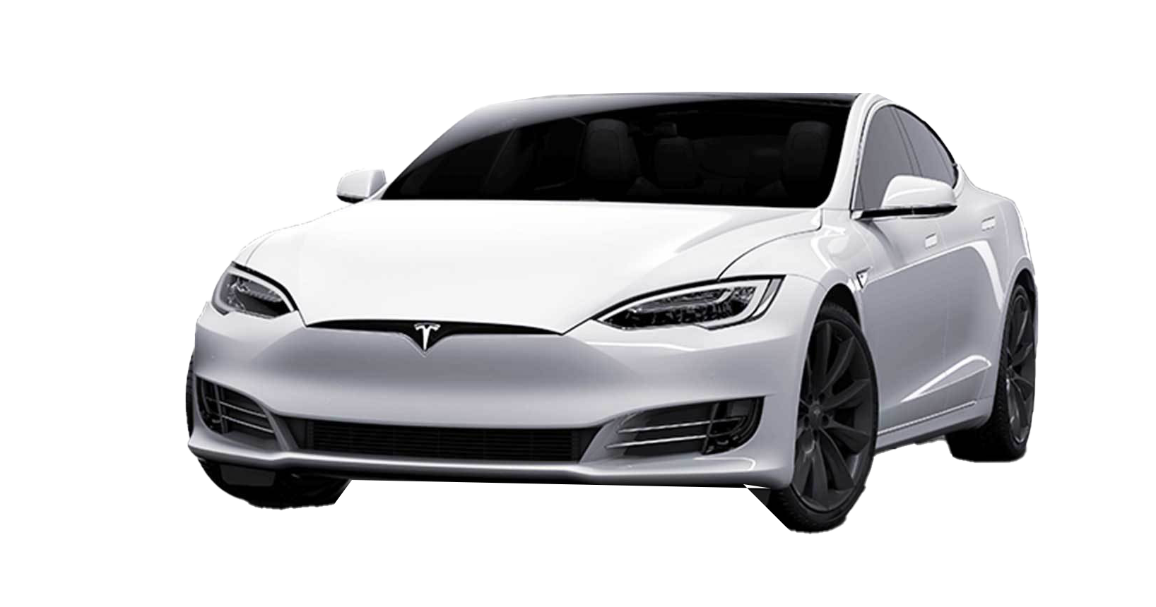

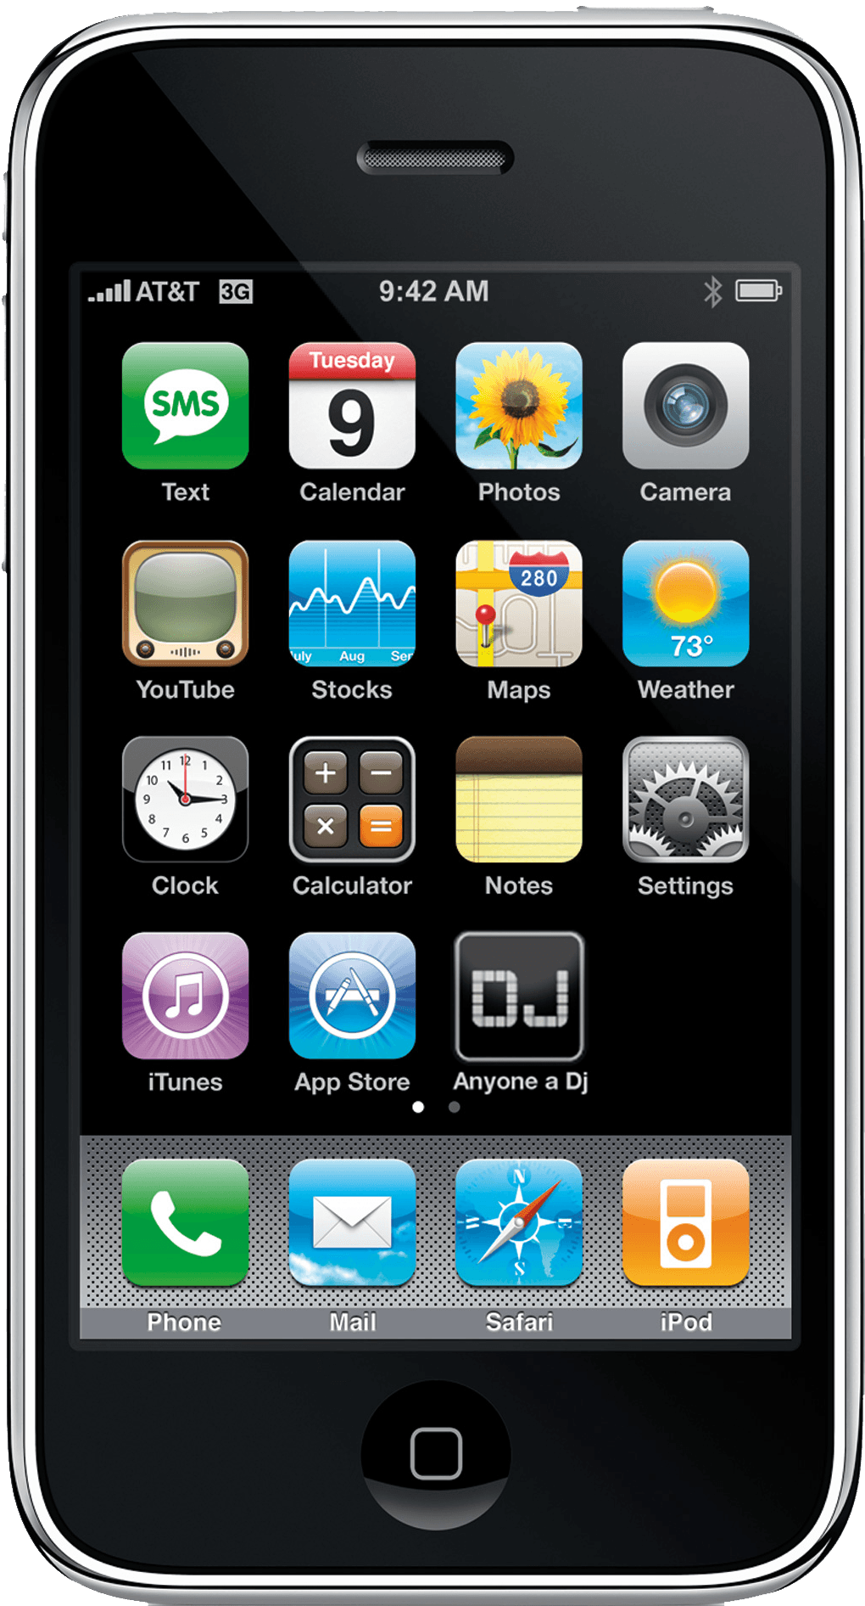
Cricket Flour in other contexts…
Henry Ford - 1st quadricycle
Elon Musk - Tesla
Steve Jobs - 1st smartphone
Notes:
Riusciamo a immaginarci
- cos’hanno in comune? Benefici ma tanta perplessitá all’inizio. Ed é quella che si chiama RESISTENZA AL CAMBIAMENTO

Slide 7

What is the Cricket Flour of Identity?

Slide 8


DECENTRALIZED IDENTITY
Notes:
Vi mostreró che ha tutte le carte per essere definita farina di grilli, perché sulla carta anch’essa offre innumerevoli vantaggi ma sta facendo fatica ad affermarsi ed ad essere adottata.
Siccome andró a toccare alcuni aspetti tecnici, spero di fare cosa gradita riepilogare un paio di nomi.

Slide 9


What does Decentralized Identity mean?
DECENTRALIZED
≠
BLOCKCHAIN

Slide 10


Definitions & Glossary
Decentralized Identifier (DID)
it’s a unique URI-based identifier associated with an entity (e.g, did:example:123456abcdef) that owns at least a key pair

Slide 11

Definitions & Glossary
Decentralized Identifier (DID)
it’s a unique URI-based identifier associated with an entity (e.g, did:example:123456abcdef) that owns at least a key pair
Verifiable Credential (VC)
it’s nothing more than a JSON object with a proof signed by the issuer

Slide 12


Definitions & Glossary
Decentralized Identifier (DID)
it’s a unique URI-based identifier associated with an entity (e.g, did:example:123456abcdef) that owns at least a key pair
Verifiable Credential (VC)
it’s nothing more than a JSON object with a proof signed by the issuer
Verifiable Presentation (VP)
it’s another JSON object containing VC(s) with another proof this time from the holder

Slide 13




What does Decentralized Identity mean?
Holder
Issuer
Verifier

Slide 14



Decentralized is like Cricket Flour in Identity
Decentralized Identity
User
Centric
Secure
Interoperable

Slide 15


There are shining examples…
Zug’s Decentralized ID (uPort)
California Driver License (SpruceID)
The world’s first live implementation of a self-sovereign government-issued identity on Ethereum (2017)
In 2023, Spruce ID has partnered with the State of California DMV to bring Mobile Driving Licenses to residents

Slide 16





Standards, Protocols, and Regulations
The eIDAS2 forces the adoption of decentralized identities and wallets in Europe.
SPID will be unused by the end of
2025
&

Slide 17



Standards, Protocols, and Regulations
The eIDAS2 forces the adoption of decentralized identities and wallets in Europe.
SPID will be unused by the end of
2025
&

Slide 18




Standards, Protocols, and Regulations
The eIDAS2 forces the adoption of decentralized identities and wallets in Europe.
SPID will be unused by the end of
2025
&

Slide 19


Standards, Protocols, and Regulations
OpenID for Verifiable Credentials
A new standardized way to present and verify Verifiable Credentials
The eIDAS2 forces the adoption of decentralized identities and wallets in Europe.
SPID will be unused by the end of
2025
&

Slide 20

Standards, Protocols, and Regulations

Slide 21
Standards, Protocols, and Regulations
It’s a European Regulation that aims to give citizens secure digital services they can use all over Europe. Among them:
Bring back sovereignty to the users
Be GDPR compliant
More interoperability and integrability inside the UE

Slide 22
Standards, Protocols, and Regulations
It’s a European Regulation that aims to give citizens secure digital services they can use all over Europe. Among them:
Bring back sovereignty to the users
Be GDPR compliant
More interoperability and integrability inside the UE

Slide 23

Standards, Protocols, and Regulations
It’s a European Regulation that aims to give citizens secure digital services they can use all over Europe. Among them:
Bring back sovereignty to the users
Be GDPR compliant
More interoperability and integrability inside the UE
The eIDAS2 forces the adoption of decentralized identities and wallets in Europe.

Slide 24

Standards, Protocols, and Regulations
It’s a European Regulation that aims to give citizens secure digital services they can use all over Europe. Among them:
Bring back sovereignty to the users
Be GDPR compliant
More interoperability and integrability inside the UE
The eIDAS2 forces the adoption of decentralized identities and wallets in Europe.

Slide 25
Standards, Protocols, and Regulations

Slide 26

Standards, Protocols, and Regulations
IT Wallet

Slide 27

Standards, Protocols, and Regulations
IT Wallet
SPID will cease operation by
2025

Slide 28


Don’t be afraid! Monokee is here
is
for
Decentralized Identity

Slide 29


Don’t be afraid! Monokee is here
is
for
Decentralized Identity
vi
… and if you use our is also super easy and effortless for you

Slide 30
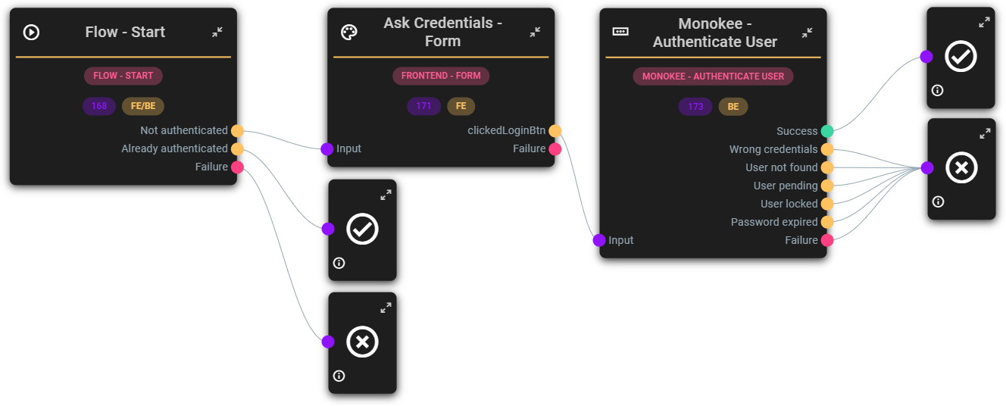
Use case 1 – Effortless transition
Login with Username and Password

Slide 31

Use case 1 – Effortless transition
Login with Username and Password

Slide 32
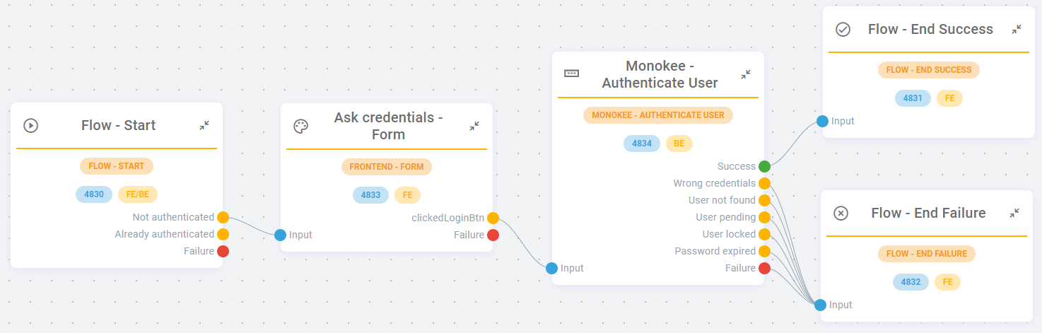
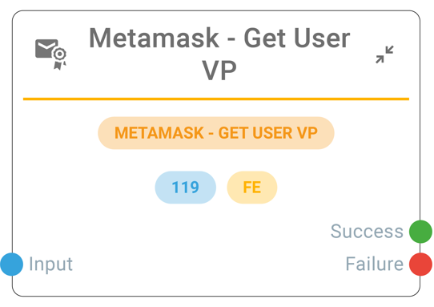
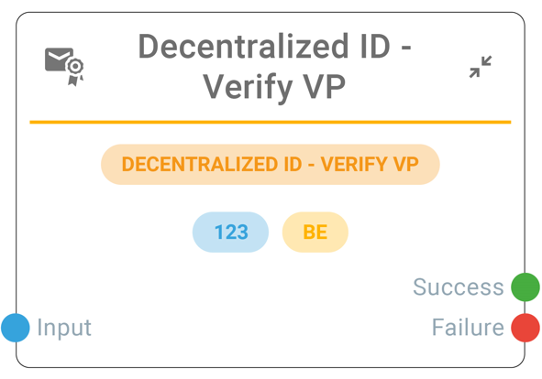
Use case 1 – Effortless transition
Login with Username and Password

Slide 33

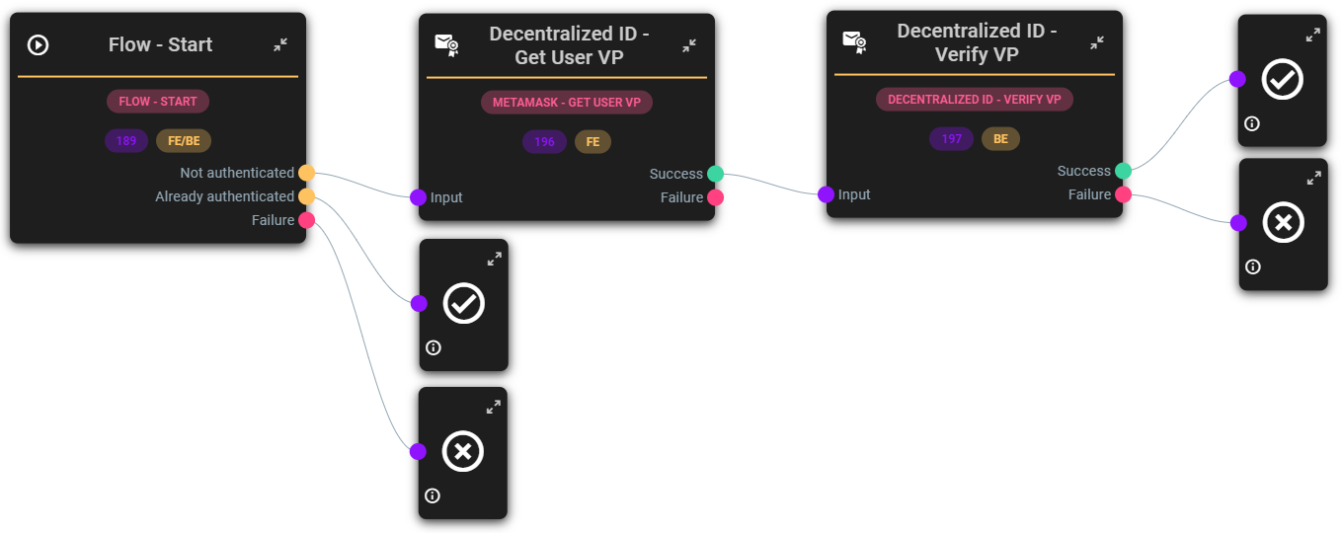


Use case 1 – Effortless transition
Login with Verifiable Credentials

Slide 34
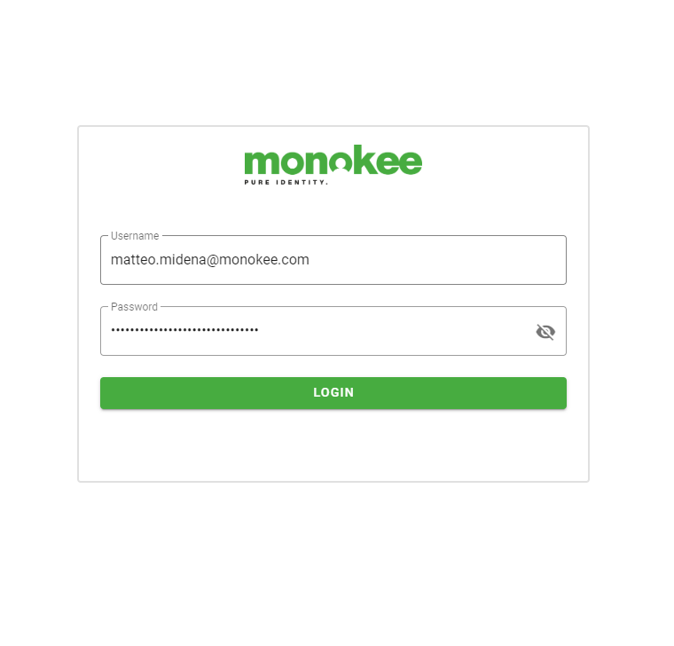
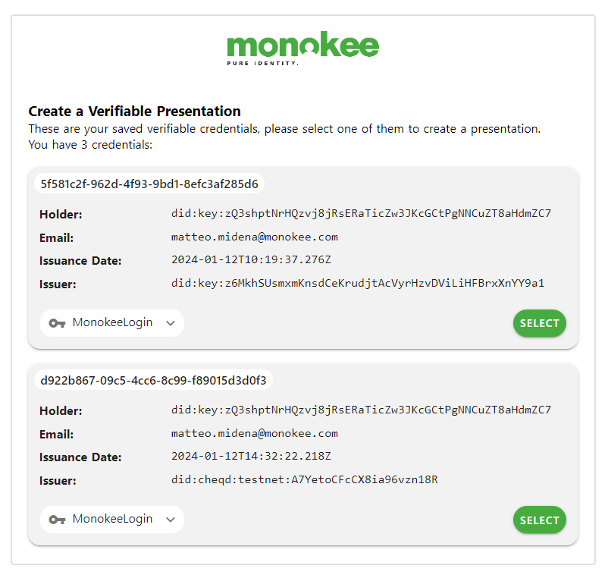
Use case 1 – Effortless transition
from centralized…
to decentralized!

Slide 35


Use case 2 – Present DL (through OpenID for VP)
User’s
Wallet
User
Verifier

Slide 36
Use case 2 – Present DL (through OpenID for VP)
User’s
Wallet
User
Verifier
Generate AuthZ Request
1

Slide 37
Use case 2 – Present DL (through OpenID for VP)
User’s
Wallet
User
Verifier
Generate AuthZ Request
1
Retrieve AuthZ request data
2

Slide 38
Use case 2 – Present DL (through OpenID for VP)
User’s
Wallet
User
Verifier
Generate AuthZ Request
1
Retrieve AuthZ request data
Driver
License
2

Slide 39
Use case 2 – Present DL (through OpenID for VP)
User’s
Wallet
User
Verifier
Generate AuthZ Request
1
Retrieve AuthZ request data
2
Generate an AuthZ response with the user’s DL inside a VP
3

Slide 40

Please
welcome again on stage
Prof.
Giorgia
Dragoni
Director Digital & Sustainable Observatories

